Slide 1
Hosting PowerShell in a Debugger
PSExt – The bastard child of WinDbg and PowerShell
Notes:
Name
Company
I’m going to talk about hosting PowerShell, and in particular, hosting PowerShell in one of the Windows debuggers

Slide 2
Agenda
Background
Windbg
Extensions
PSHost
PSExt
Notes:
Why anyone would do this is a good question. Working on some obscure game
And we have a public beta were we get crash dumps from the people playing it.
Hang 1 out of 1000h played but the hangs are caused by several different bugs
determine the frequency of similar bugs

Slide 3
But Why
Notes:
Why anyone would do this is a good question. Working on some obscure game
And we have a public beta were we get crash dumps from the people playing it.
Hang 1 out of 1000h played but the hangs are caused by several different bugs
determine the frequency of similar bugs

Slide 4

Notes:
Turned out quite a lot of people were interested in the beta
Actually it was one of the most successful betas in EA history with over 10 million players
Do the math ☺

Slide 5
But Why
Crash dump analysis of hangs
The thread that causes is crash is a watch dog that monitors other thread and crashes if they don’t make progress.
Analysis required across call stacks. For example thread x is holding a lock that thread Y tries to acquire.
There are more than one dump

Slide 6
What is WinDbg/cdb
Debuggers that ships with the Windows SDK
Command line oriented
Very arcane
Very powerful, lots of control
Has an extension model, i.e. you can write your own dll that extends the functionality of the debugger.
Has a scripting language
Notes:
Low footprint, optimized to be installed on a customers domain controller for remote debugging
Command line oriented:
Visual Studio has lots of gui features that makes it really streamlined for the majority of scenarios
But if you are here, you have understood how Powerful a command line interface can be
* Extension model
* We will look more into this
Scripting language
If it already has a scripting language, aren’t we done?

Slide 7
Scripting in WinDbg
$$ Get process list LIST_ENTRY in $t0. r $t0 = nt!PsActiveProcessHead $$ Iterate over all processes in list. .for (r $t1 = poi(@$t0); (@$t1 != 0) & (@$t1 != @$t0); r $t1 = poi(@$t1)) { r? $t2 = #CONTAINING_RECORD(@$t1, nt!_EPROCESS, ActiveProcessLinks); as /x Procc @$t2 $$ Get image name into $ImageName. as /ma $ImageName @@c++(&@$t2->ImageFileName[0]) .block { .echo ${$ImageName} at ${$Procc} } ad $ImageName ad Procc }
WTF

Slide 8
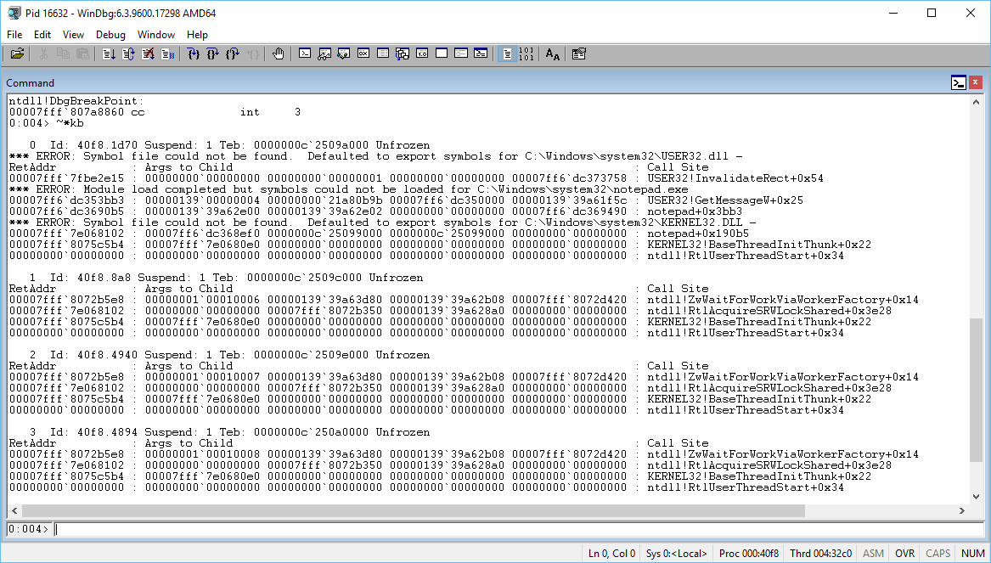
Demo of windbg/cdb
Notes:
Lm
k
~*kb
dv
Dt
.load

Slide 9
Extensions
A few exported functions:
HRESULT DebugExtensionInitialize(_Out_ PULONG Version, _Out_ PULONG Flags);
void CALLBACK DebugExtensionUninitialize(void);
typedef HRESULT ( CALLBACK *PDEBUG_EXTENSION_CALL)(_In_ PDEBUG_CLIENT Client, _In_opt_ PCSTR Args);
Traditionally written in C/C++
Principles of C++:
Trust the programmer.
You don't have to pay for something you don't need.
Don't break existing code.
Prefer compile time errors over run time errors.
Notes:
Anyone see the fundamental flaw here?
Never ever trust a programmer! I’m not just saying this. Just don’t.
And I can prove it to you. Show any programmer some code he wrote 5 years ago. He will invariably say “Who is the idiot that wrote this crap?”
And will probably think it’s a bug in his version control system when it blames him.

Slide 10
PSExt
PSExt uses the extension model of the Windows debuggers to make it possible to use PowerShell pipelines in the debuggers.
Hosting PowerShell
Runspace
Represents the operating environment for command pipelines
PSHost
A host provides communications between the Windows PowerShell engine and the user

Slide 11
DbgCmdlets
DbgPSHost
IDebugger
System.Management.Automation
DebuggerProxy : IDebugger
DebuggerDispatcher
Debugger : IDebugger Symbols/Threads/Breakpoints/Modules/Variables
Native Debugger (dbgeng.dll)

Slide 12
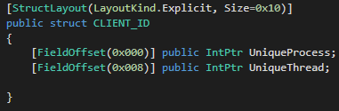
Generating interop C# classes
Debuggers knows how types are layed out if they have symbols.
dt –v <typename>
C# can specify memory layout of structs/classes with [LayoutKind] and [FieldOffset] attributes
PowerShell can munge text

Slide 13
Debugger
Extension
PowerShell
GetCallstackCommand.ProcessRecord()
!ps Get-Callstack
PS.InvokeAsync()
DispatchCalls()
Debugger.
GetCallstack()
Dispatcher
DebuggerProxy.GetCallstack()
IDebug*()
IDebugControl.Output()
Debugger.
WriteLine()
DebuggerProxy.Write(output)
DbgHost.Write(output)
Debugger thread
PowerShell thread

